Slide 1
GUI for Parallel Computing Lab
By:
Wilberto Lopez

Slide 2
The GUI
The GUI is an applet that will work as an interface between the web and a computer cluster.
Java implementation.
Nodes
Internet
4
8
12
gui
FrontEnd
3
7
11
2
6
10
1
5
9
USER

Slide 3
Purpose and Capabilities
The main purpose is to teach the student about parallel computing by:
    Explaining concepts
    Showing examples
    Exercising the student
    Let them Interact
Notes:
Parallel Computing -> Specially the performance part. And explain how

Slide 4
MPI
We will use MPI to realize the communication between frontend and the cluster.
MPI (Message Passing Interface) is a C library used for passing “messages ” among nodes.
  A message can contain data and instructions
This is the tool that the students would be using in the lab to see parallel computing

Slide 5
Details
Theme of this lab is Performance
Divided into 3 Activities – 3 tasks each.
  Task1 - Theory
    Activity 1 – parallel computing & performance explanation
    Activity 2 - parallel computing & performance explanation
    Activity 3 - exercise
  Task2 – Practice
    Activity 1 – trapezoidal rule exercise
    Activity 2 – code modification and compilation
    Activity 3 – code correctness verification
  Task3 – Visualization and Comparisons
    Activity 1 – Profiling commands
    Activity 2 – Jumpshot visualization and gannt chart
    Activity 3 – practical and theorical comparations

Slide 6
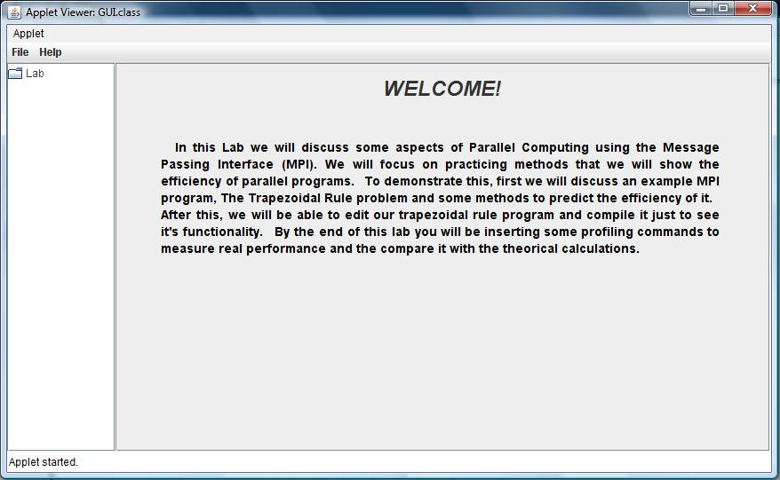
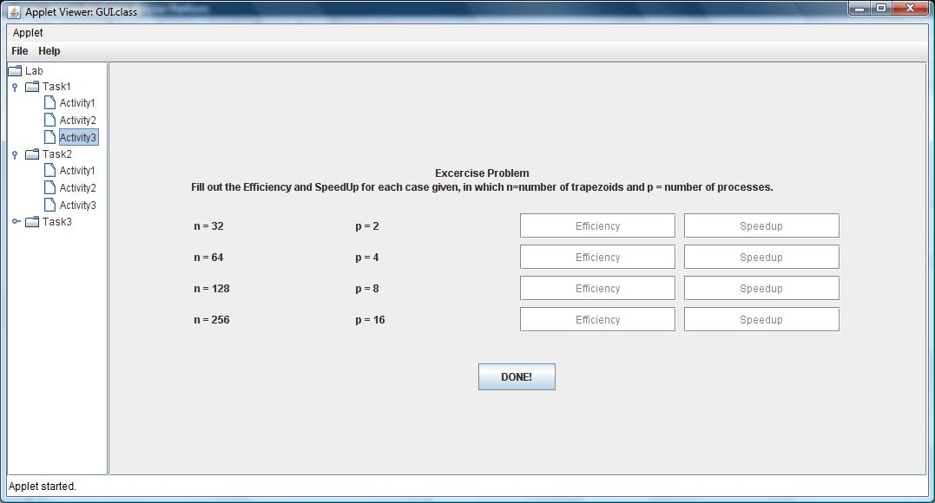
Engine

Slide 7
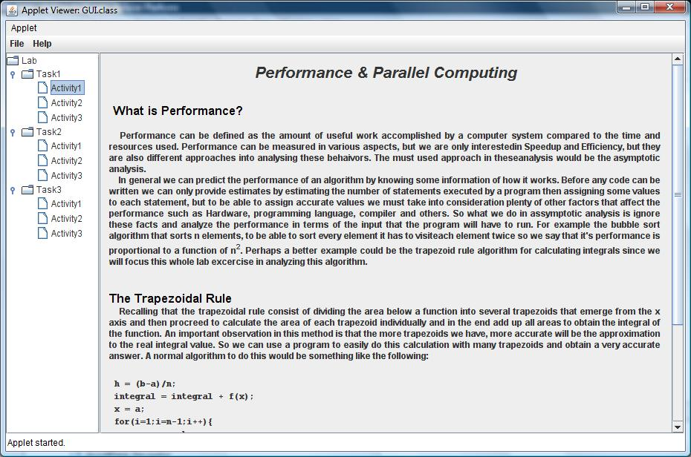
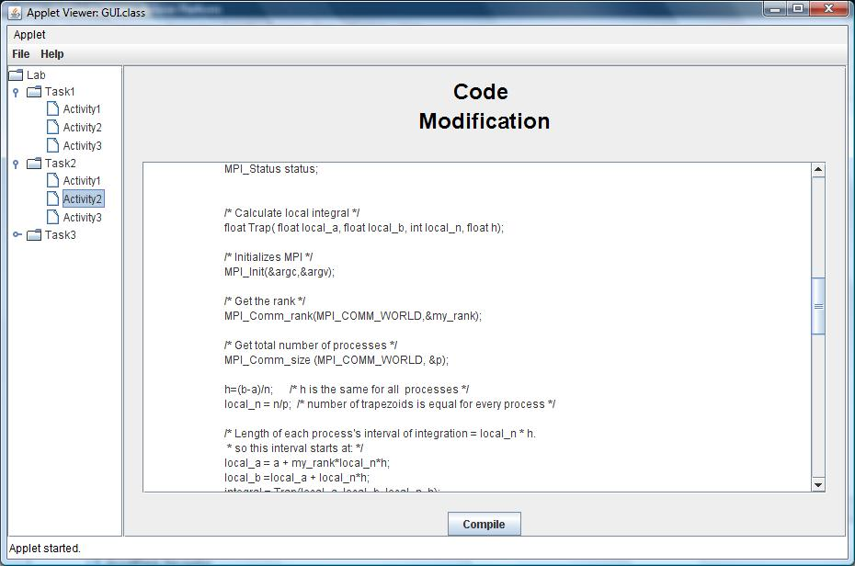

Slide 8
Trapezoidal rule example
The GUI uses as an example the trapezoidal rule algorithm since it can be parallelized easily.
Throughout the GUI we discuss it’s functionality and we give special emphasis in analyzing it’s performance
Notes:
Consist of…

Slide 9
43
58
69
23
17
2π
1 2 3 4 5 6

Slide 10
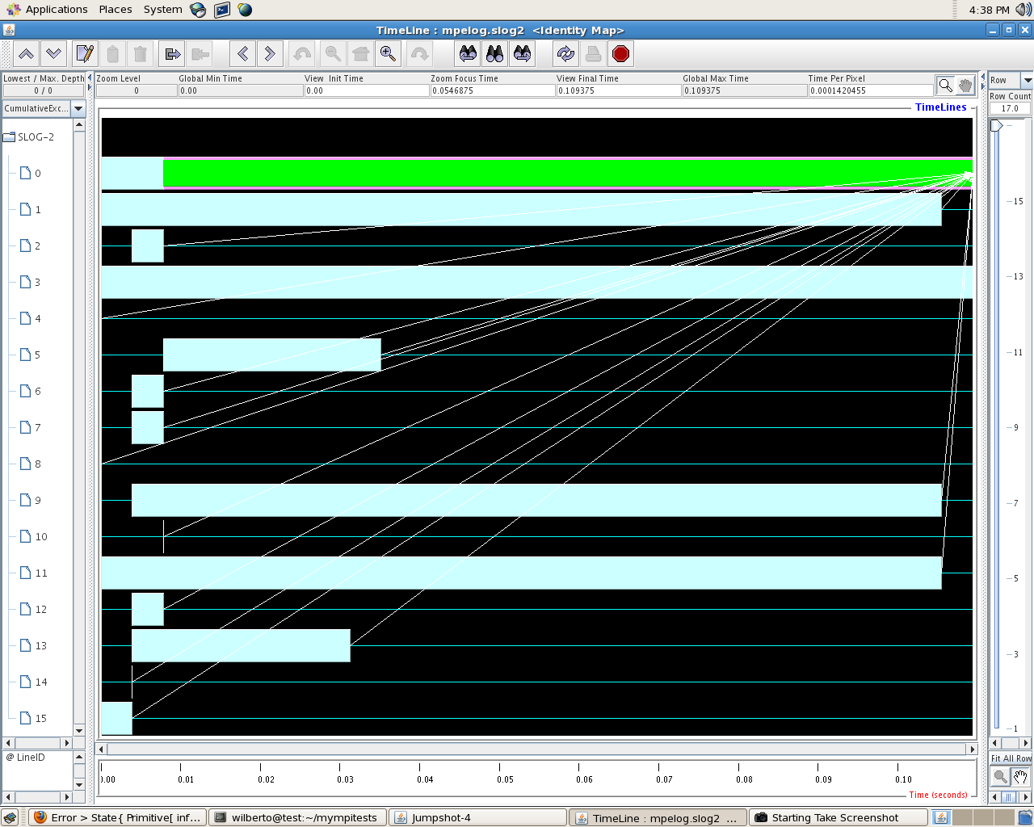
Currently working on…
Jumpshot Visualization tool

Slide 11
QUESTIONS?

